Slide 1
Using Writing As a Tool for Economic Research
Creating knowledge by constructing competing arguments

Slide 2
Creating knowledge by constructing competing arguments
Tools of constructing competing arguments:
Mental Processes – thinking about an argument;
Oral Discourse – verbalizing the argument;
Mathematics – manipulating equations to derive meaning; and
Writing
  Writing as a Product, a form of communication to disseminate research results;
  Writing as a Process for deriving the research results.

Slide 3
Writing as a process
Writing as a process is called composition. Composition includes both analysis (taking something apart to understand it) and synthesis (putting pieces together to make a whole). Composition involves searching for relationships among the facts and ideas that make up the raw material of your research. When you compose, you choose and arrange those facts and ideas; you try to put them in the most meaningful order.

Slide 4
The pyramid structure of an argument
Scholarly Writing:
The purpose of scholarly writing is to make an argument that is persuasive to experts in the field. Scholars use the composition process to discover and refine their arguments. The completion of the scholarly writing results in a logical, hierarchical structure in which the thesis is supported by a series of nested arguments that lead logically to the thesis as a conclusion.

Slide 5
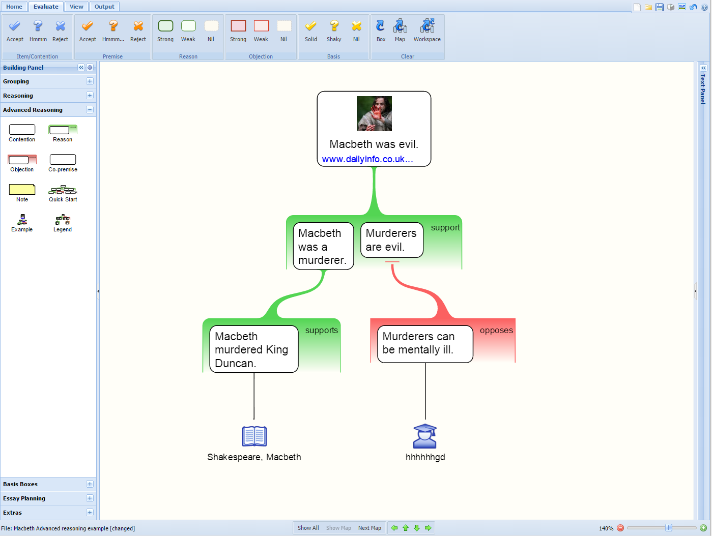
The pyramid structure of an argument

Slide 6
The pyramid structure of an argument
Every argument consists of assertions and evidence, or state it differently, every argument consists of assumptions and conclusions. For the pyramid depicted in the previous slide:
Primary Assertion : Macbeth was evil
Major Reasons: He murdered the king; Murderers are evil
Supporting Points: Macbeth murdered King Duncan; Murderers can be mentally ill.

Slide 7
reasoning
Scholars use three approaches to reasoning:
Deductive Reasoning;
Inductive Reasoning; and
Warrant-Based Reasoning.

Slide 8
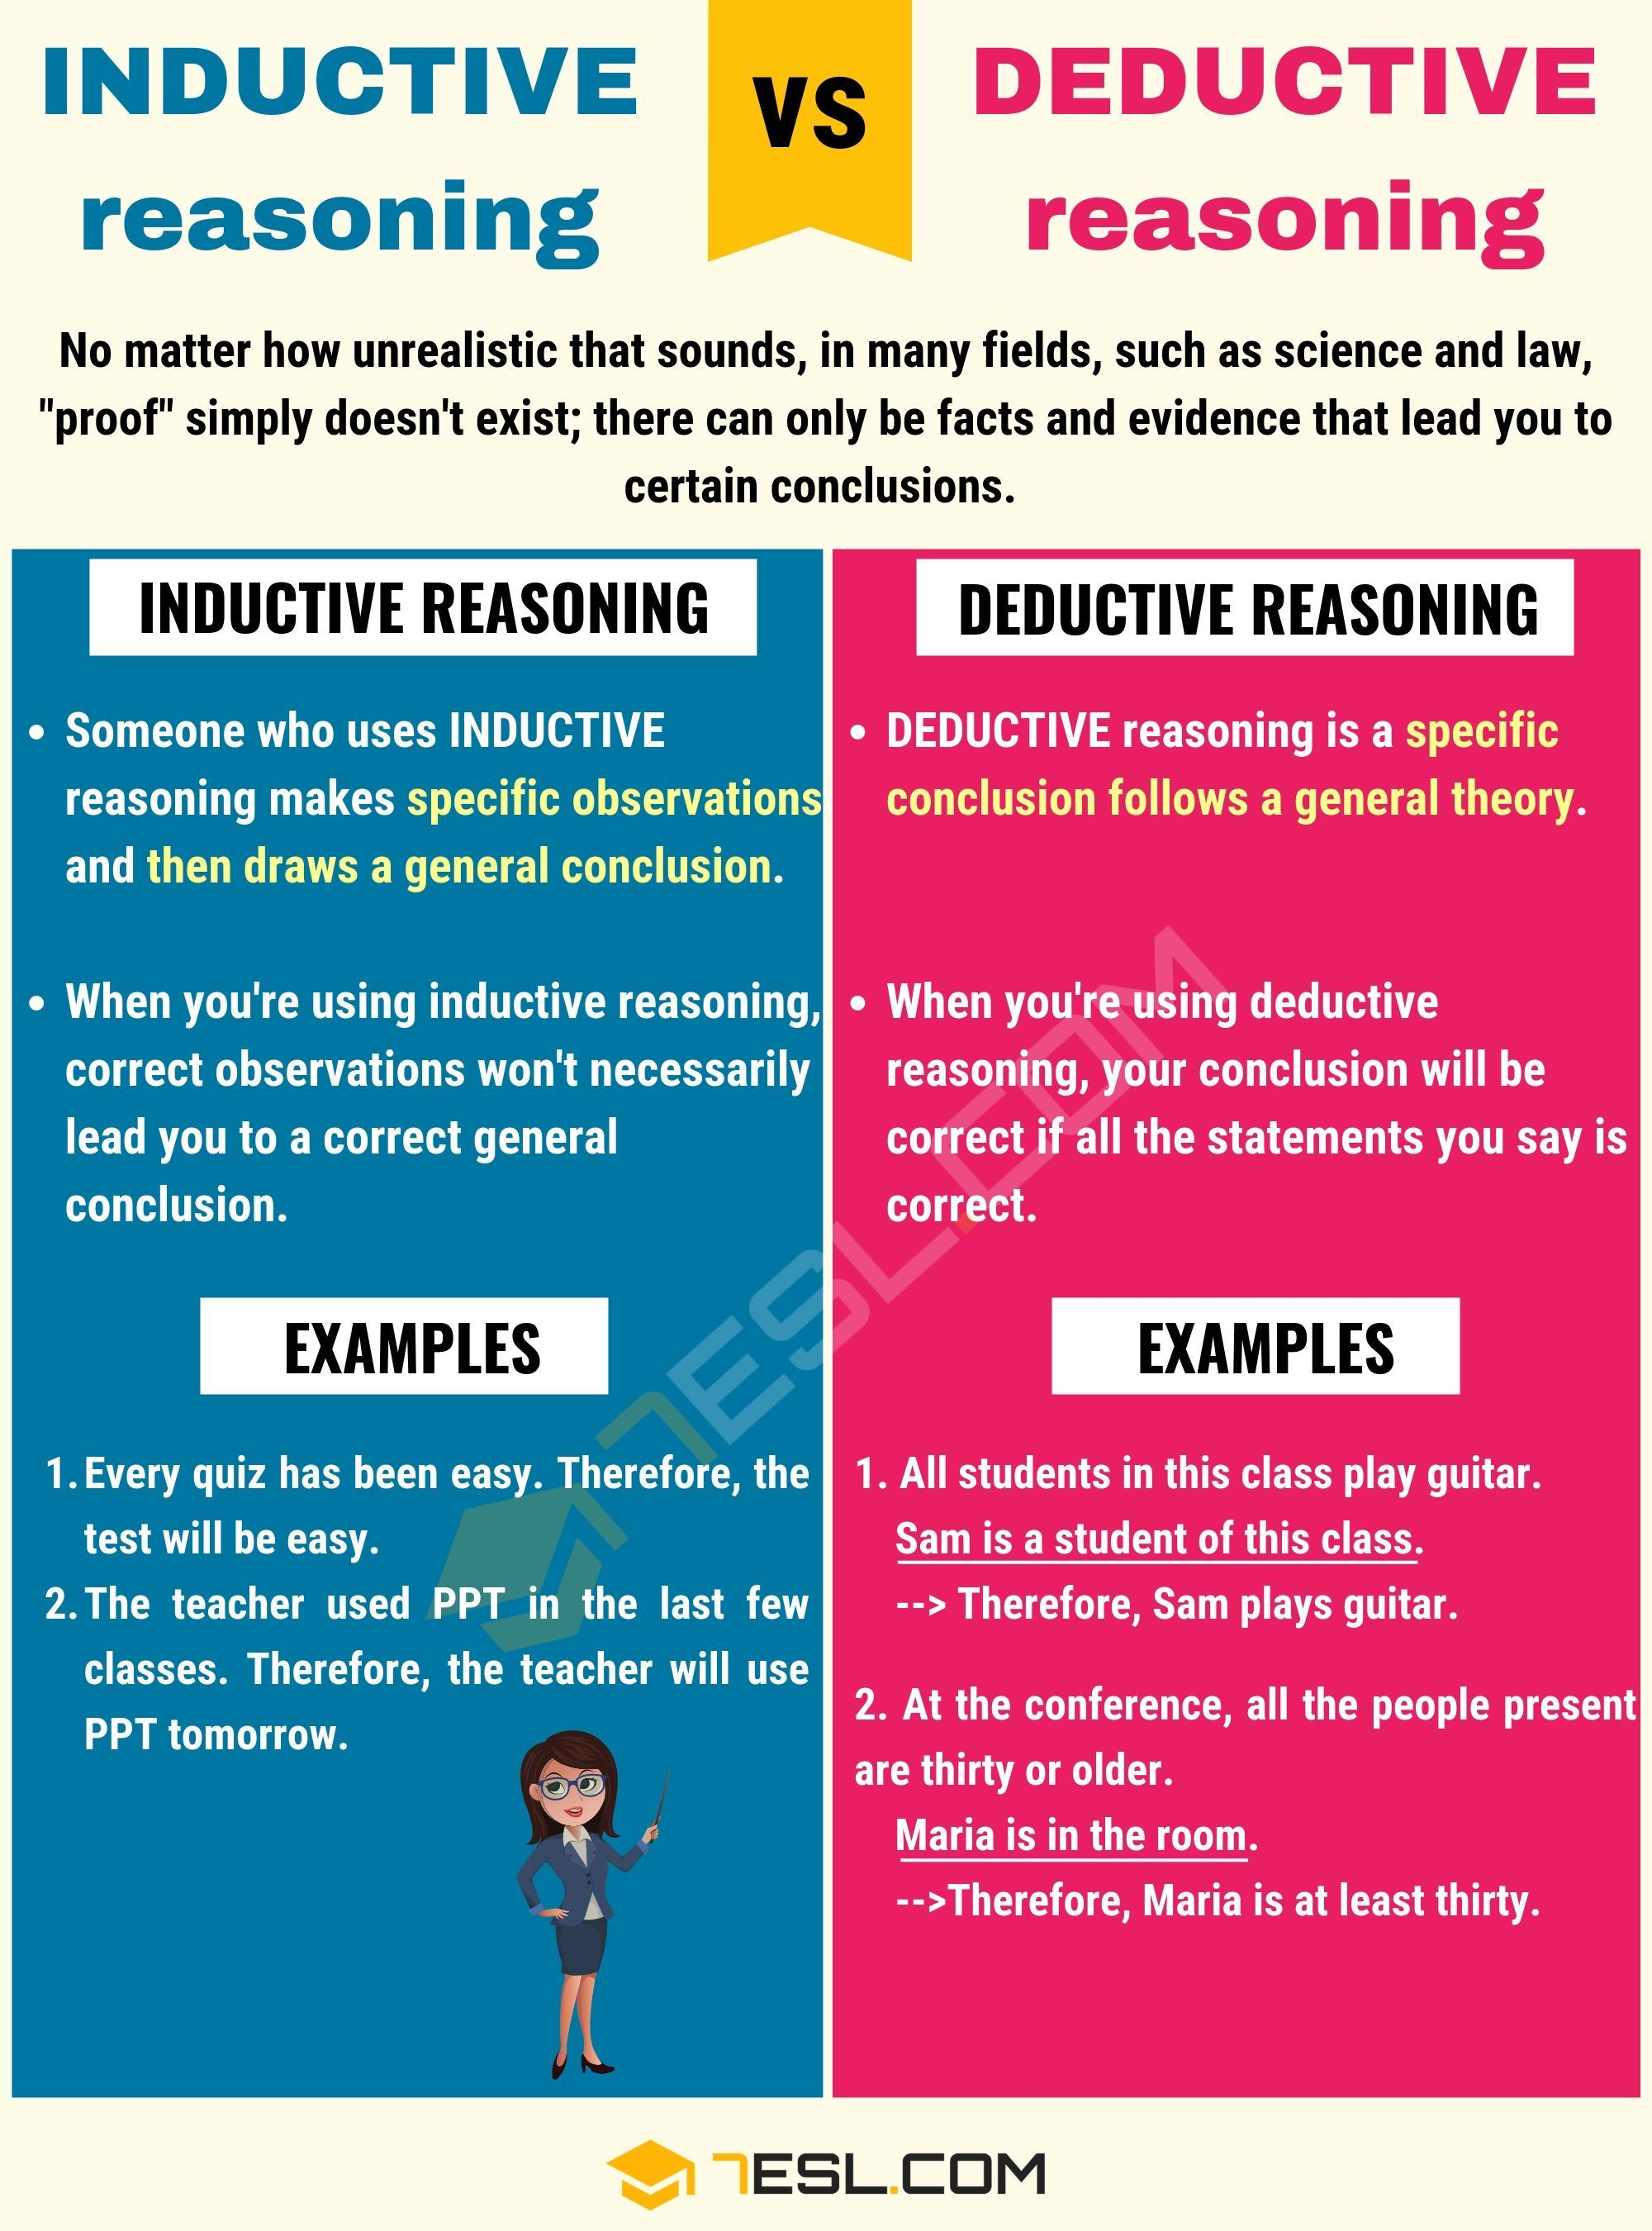

Slide 9
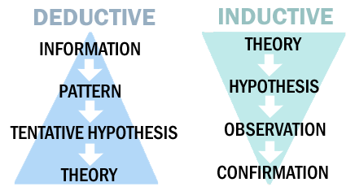
Deductive vs. inductive reasonings

Slide 10
Warrant-based reasoning
Toulmin Argument // Purdue Writing Lab

